Slide 1


Data Science Framework Report Mauricio Carvajal

Slide 2

Agenda
Problem statement
Proposal data science process framework
Data management
Risk management
Insights

Slide 3
Problem statement Goals
Over the past year or so Credit One has seen an increase in the number of customers who have defaulted on loans they have secured from various partners, and Credit One, as their credit scoring service, could risk losing business if the problem is not solved right away.
Give a prediction in are going to be the possible new customers with problems
Give insides on what the actual situation of the business
Base on data, recommendations on how improve the situation

Slide 4
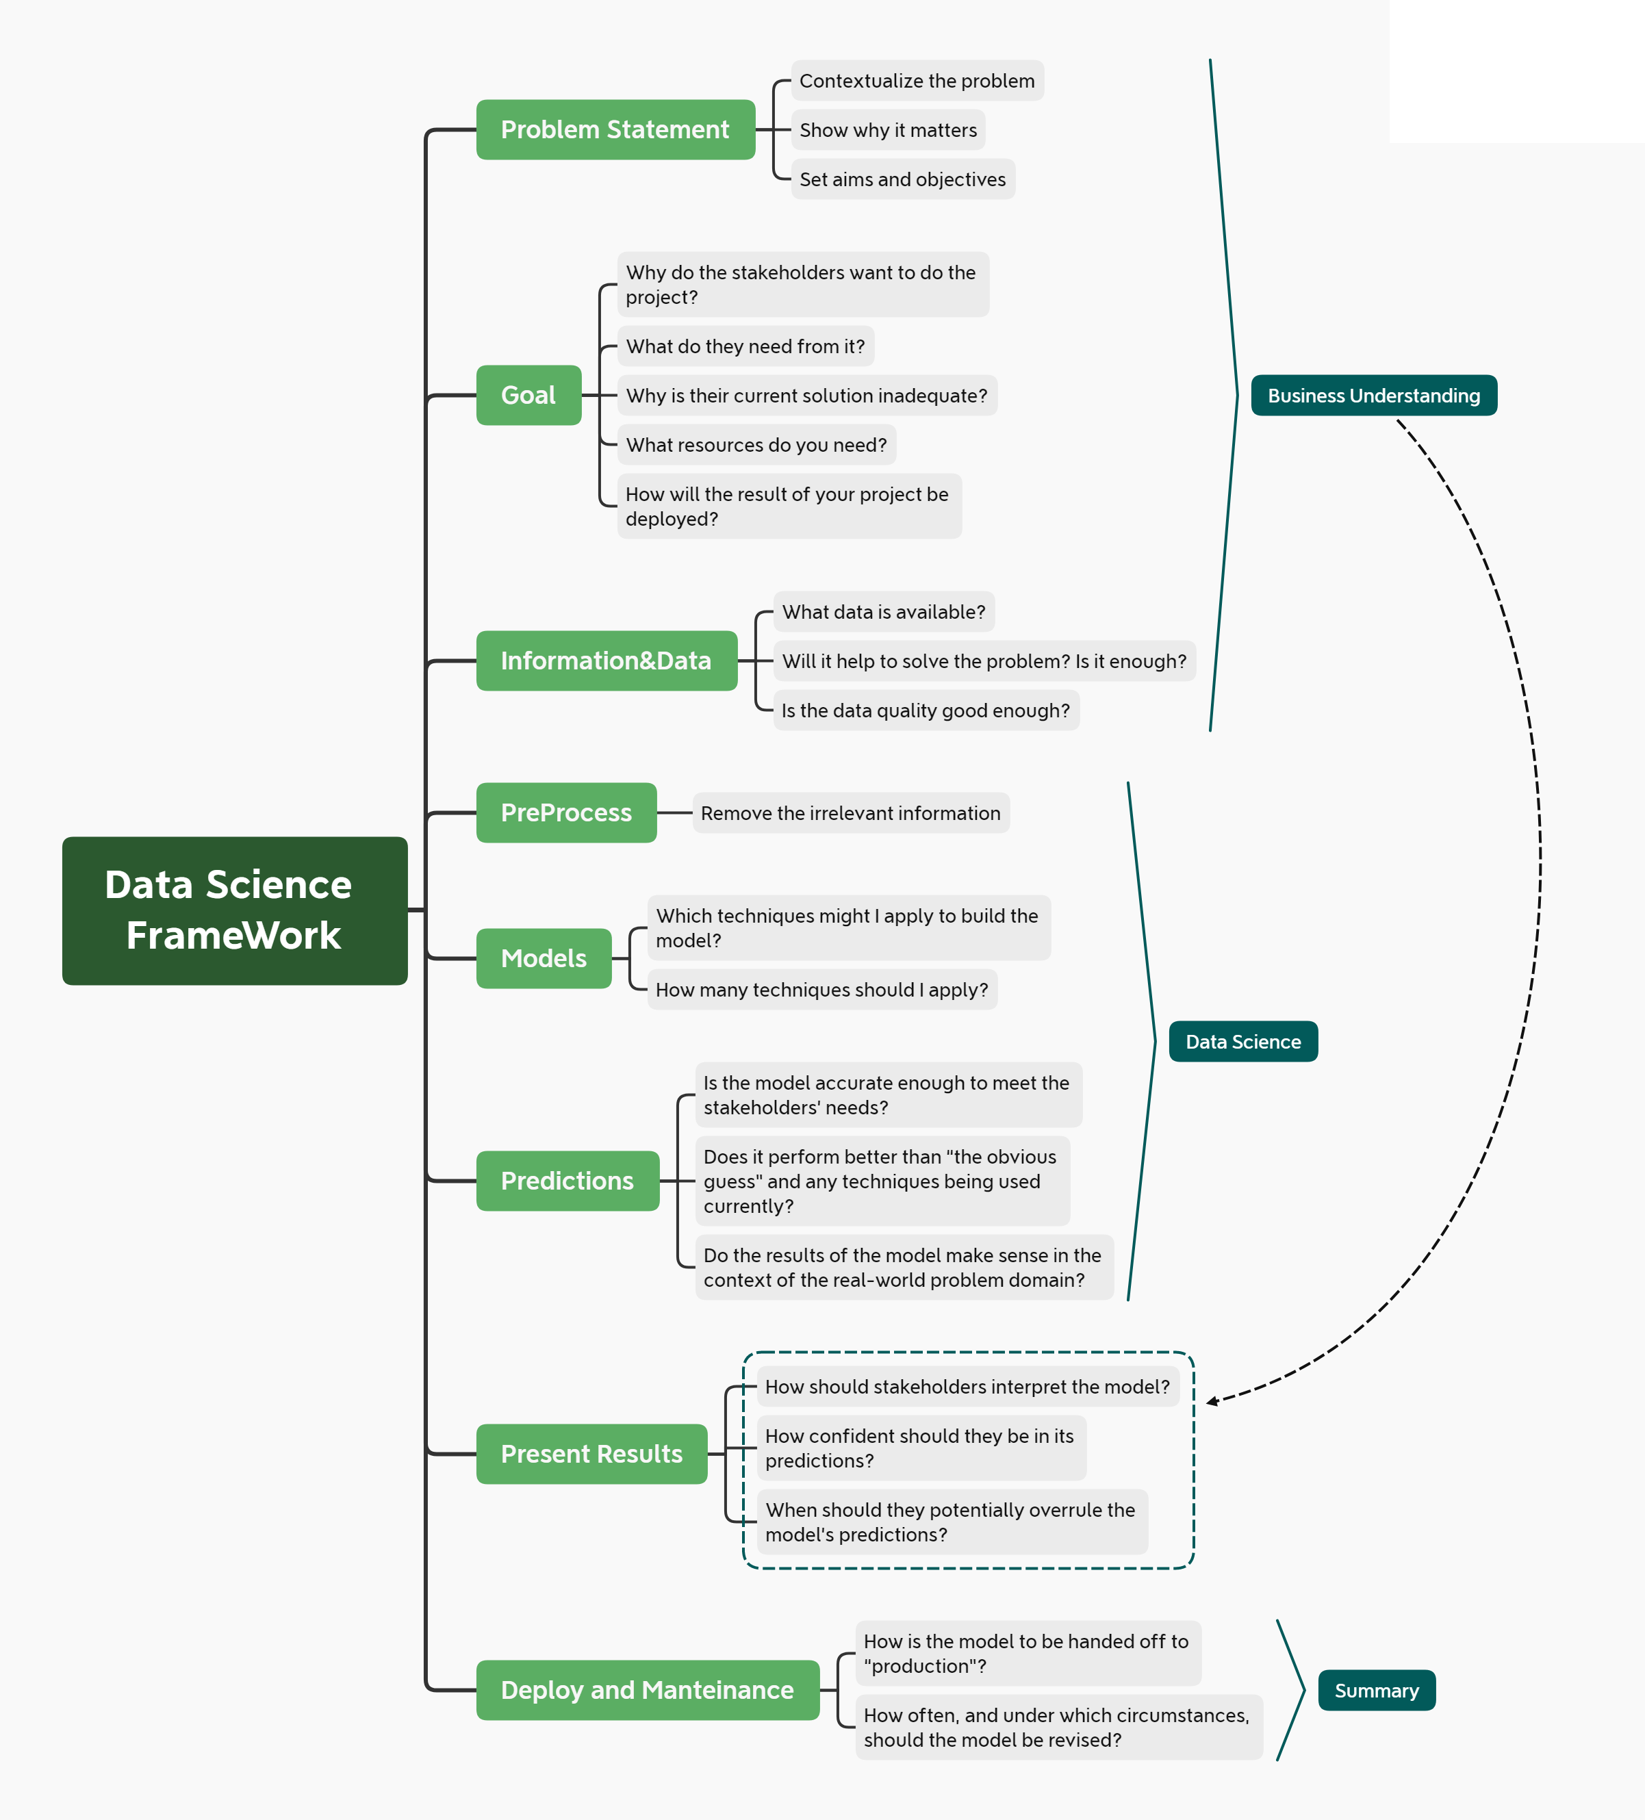
Data Science Framework
Base on the model :
Zumel and Mount
Divided in 3 groups:
Business understanding
Data Science (data manipulation)
Deploy and maintenance

Slide 5

Information of the data
Amount of the given credit
Gender
Education
Marital status
Age (year)
History of past payment
Amount of bill statement
Amount of previous payment
client's behavior

Slide 6

Data Management
1- Understanding Data
Need to convert the data, numerical to categorical
2-Proproces the information
Find a method to discard irrelevant information
Correlation, PCA, Feature variance, recursive feature elimination
3- Find the best model
Use different machine learnings models: RF,SVM,KNN C5.0
Evaluate the best performance
Kappa, accuracy
4-Use the best model to predict the results define in our problem statement

Slide 7

Risk Data management
Need to have clear understanding of the type of the data.
Conversion from numerical to categorial as needed
Understand if the problem is classification or regression problem
The time that is needed to build the models

Slide 8

Thank You
lmauriciocarvajal@gmail.com

